Slide 1
Terraform, Jenkins and GitHub Actions
Training

Slide 2
Agenda
https://docs.google.com/document/d/1oVlTkaQyEzkeqdh-a7Qi5iZJExVBSeEP/edit?usp=sharing&ouid=108972485768906927376&rtpof=true&sd=

Slide 3
Training Format
Concepts
Hands-on exercises
Challenge/Assignments 15 to 20 min
Interactive

Slide 4
Timing
Start time at 11 am
Lunch - 1pm to 2pm
Break - 3 .30 pm
End at 5.30 pm

Slide 5
Lab Setup
Ubuntu VM and Configurations

Slide 6
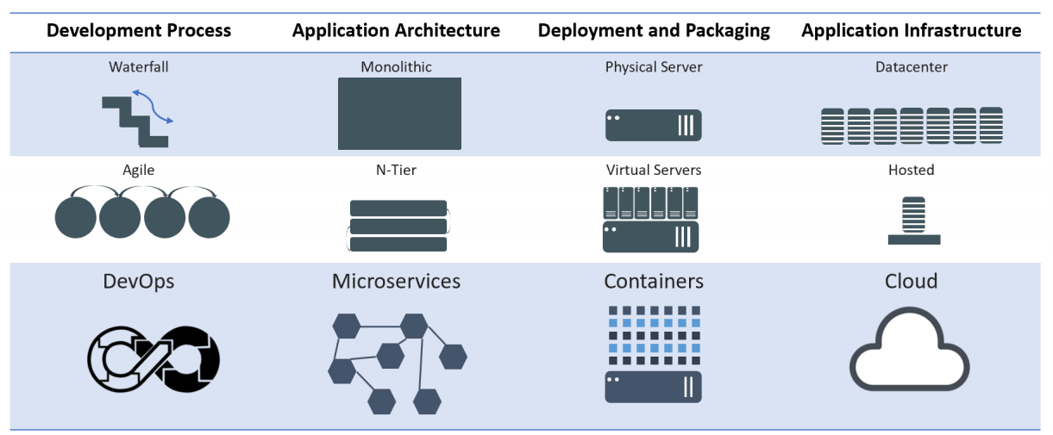
Evolution of Computing
Notes:
Mention WHY the evolution and benefits of adapting to new practices

Slide 7
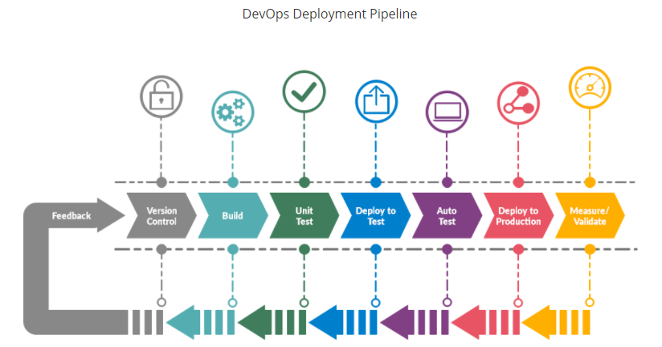

Slide 8
Infrastructure as code
Infrastructure as Code (IaC) is an approach to managing and provisioning infrastructure in a way that treats infrastructure configurations as code.
This means that you use code, typically in a declarative or imperative language, to define and automate the setup, configuration, and management of your infrastructure, including servers, networking, storage, and other resources

Slide 9
Why Infrastructure as code
Automation: IaC automates the provisioning, configuration, and management of infrastructure, reducing manual, error-prone tasks and ensuring consistency.
Version Control: Infrastructure code can be versioned, allowing for tracking changes, rollbacks, and collaboration among team members using tools like Git.
Scalability: IaC makes it easier to scale infrastructure resources up or down based on demand, adapting to changing workloads.
Reproducibility: With IaC, you can recreate entire environments reliably, ensuring consistency between development, testing, and production.
Documentation: Infrastructure code serves as documentation, making it easier to understand and maintain infrastructure configurations.

Slide 10
Why Infrastructure as code
Collaboration: Teams can work together on infrastructure code, enabling collaboration between developers and operations personnel.
Cost Efficiency: IaC can help optimize resource allocation and reduce wastage by defining infrastructure requirements more precisely.
Security: Security policies and best practices can be codified and enforced in the infrastructure code, enhancing the security of your environment.
Portability: Infrastructure definitions can be used across different cloud providers or on-premises environments, promoting flexibility.
Change Management: IaC provides a structured approach to making changes to infrastructure, ensuring that modifications are planned and tracked.

Slide 11
Terraform
Terraform is an open-source Infrastructure as Code (IaC) tool developed by HashiCorp.
It is designed to help organizations manage and provision infrastructure resources in a declarative and automated way.
Terraform allows you to define, configure, and version your infrastructure using a domain-specific language or HashiCorp Configuration Language (HCL).

Slide 12
Why Terraform
Declarative Syntax: Terraform uses a declarative syntax to define the desired state of your infrastructure. You specify what resources you need, their configurations, and their dependencies, without specifying how to achieve that state.
Providers: Terraform supports a wide range of cloud providers (e.g., AWS, Azure, Google Cloud), as well as other infrastructure components like databases, networking, and more. These providers allow you to interact with various services and resources.
State Management: Terraform maintains a state file that keeps track of the current state of your infrastructure. This state file is used to plan and apply changes while ensuring that the desired state matches the actual state.
Execution Plans: Terraform generates an execution plan before making any changes to your infrastructure. This plan outlines what actions will be taken, such as creating, updating, or destroying resources, without applying the changes immediately.

Slide 13
Why Terraform
Modularity: Terraform encourages the use of reusable modules. Modules are a way to encapsulate and share infrastructure configurations, making it easier to maintain and standardize infrastructure setups.
Version Control Integration: Terraform configurations can be stored in version control systems like Git, enabling collaboration, change tracking, and rollback capabilities.
Community and Ecosystem: Terraform has a large and active community, and a vast ecosystem of third-party modules and plugins, making it a popular choice for IaC.
Extensibility: Terraform's extensible architecture allows you to write custom providers and provisioners to interact with specific APIs or perform custom actions.

Slide 14
Why Terraform better than other IAC tools
Multi-Cloud Support: Terraform is known for its extensive support for various cloud providers, making it a great choice for organizations that operate across multiple cloud platforms. It provides a consistent way to manage infrastructure across different environments.
HCL Syntax: Terraform uses the HashiCorp Configuration Language (HCL), which many find easy to read and write. The declarative syntax of HCL allows you to express your infrastructure requirements clearly and concisely.

Slide 15
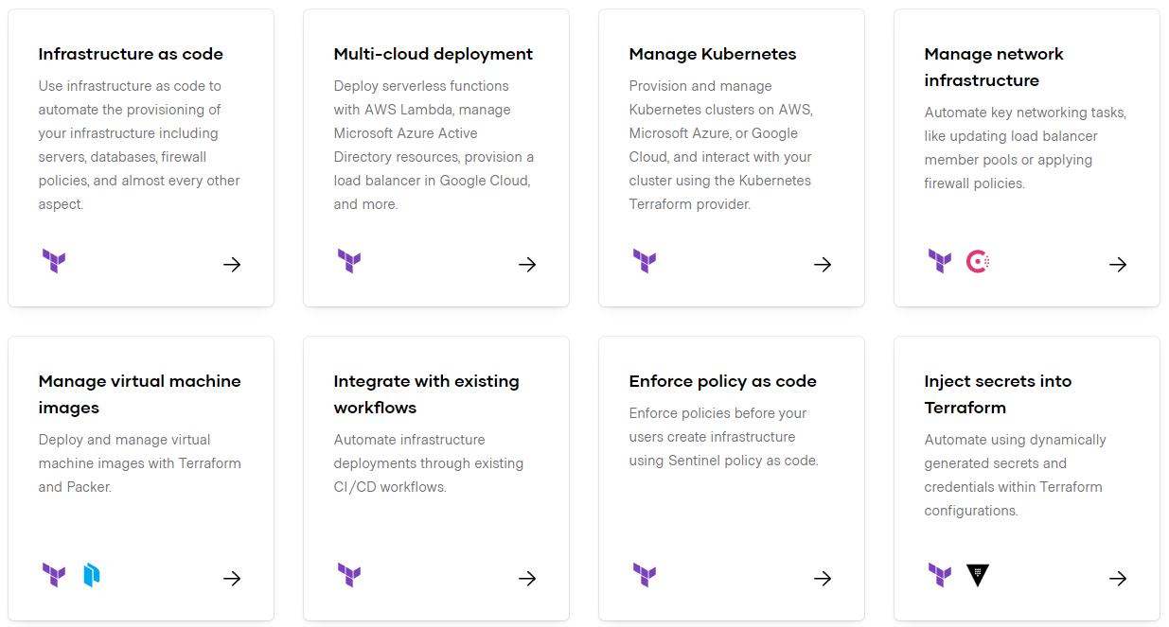
https://www.terraform.io/

Slide 16
Installation
https://developer.hashicorp.com/terraform/install

Slide 17
Exercise 1: Configure AWS CLI

Slide 18
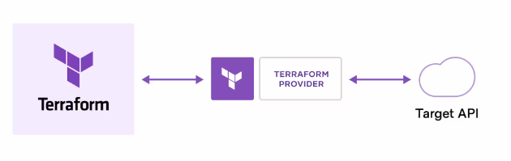
How does Terraform work?
Terraform creates and manages resources on cloud platforms and other services through their application programming interfaces (APIs). Providers enable Terraform to work with virtually any platform or service with an accessible API.
https://registry.terraform.io/

Slide 19
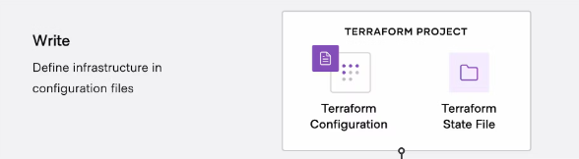
Terraform workflow stages: Write
You define resources, which may be across multiple cloud providers and services. For example, you might create a configuration to deploy an application on virtual machines in a Virtual Private Cloud (VPC) network with security groups and a load balancer.

Slide 20
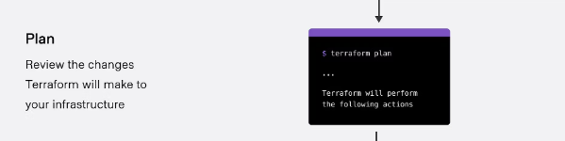
Terraform workflow stages: Plan
Terraform creates an execution plan describing the infrastructure it will create, update, or destroy based on the existing infrastructure and your configuration.

Slide 21
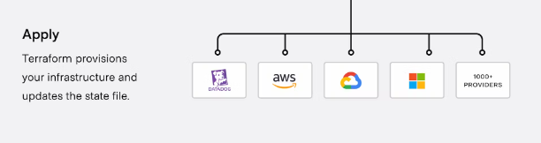
Terraform workflow stages: Apply
On approval, Terraform performs the proposed operations in the correct order, respecting any resource dependencies. For example, if you update the properties of a VPC and change the number of virtual machines in that VPC, Terraform will recreate the VPC before scaling the virtual machines.

Slide 22
Terraform HCL
HCL stands for HashiCorp Configuration Language. It is a domain-specific language (DSL) developed by HashiCorp, the company behind popular infrastructure-as-code tools like Terraform, Consul, Vault, and Packer.
HCL is used primarily for defining configurations and infrastructure in a human-readable and machine-friendly format.
HCL is designed to be easy to read and write and is used in various HashiCorp tools for defining configuration files. Some of the key features and characteristics of HCL include:
1. Declarative Syntax: HCL is a declarative language, which means you specify what you want your infrastructure to look like, and the underlying tools (e.g., Terraform) figure out how to make it happen.

Slide 23
Terraform HCL
2. Block Structure: HCL uses a block structure, with nested blocks and attributes, to define configurations. This helps maintain a clear and structured organization of configuration files.
3. Human-Readable: HCL is designed to be easily readable and writable by both humans and machines, which makes it accessible to infrastructure and DevOps engineers.
4. Variable Support: HCL supports variables, which can be used to parameterize your configuration and make it more flexible and reusable.

Slide 24
Terraform HCL
5. Interpolation: HCL allows for variable interpolation, where you can reference variables within other parts of your configuration.
6. Comments: HCL supports both single-line (`#`) and multi-line (`/* */`) comments, which are helpful for documentation and annotation.
7. Support for Multiple HashiCorp Tools: While HCL is most commonly associated with Terraform, it is also used in other HashiCorp tools like Consul, Nomad, Vault, and Packer, providing a consistent configuration language across the HashiCorp ecosystem.

Slide 25
Resources and Providers
Resources: Infrastructure components like EC2 instances, S3 buckets, databases, etc.
Providers: Plugins that enable Terraform to interact with cloud services (AWS, Azure, GCP, etc.)
Example:
provider "aws" {
region = "us-east-1"
}
resource "aws_instance" "example" {
ami = "ami-0c55b159cbfafe1f0"
instance_type = "t2.micro"
}
https://registry.terraform.io/browse/providers

Slide 26
Terraform State Files
State files track the infrastructure Terraform manages
Stored as terraform.tfstate
Helps Terraform understand the current state of resources
Allows tracking of changes between executions
Example: Terraform applies changes based on the difference between the state file and the actual cloud infrastructure

Slide 27
Desired vs. Current Infrastructure
Desired State: Defined in the Terraform configuration files
Current State: Actual deployed infrastructure
Terraform Workflow:
Write Configuration (Define desired state)
Plan (Compare with current state)
Apply (Make changes to match the desired state)
Destroy (Cleanup resources if needed)
Example: If an EC2 instance is removed from configuration, Terraform will destroy it during terraform apply

Slide 28
Terraform Basic Commands
terraform init – Initializes a Terraform working directory
terraform plan – Shows what changes will be made without applying them
terraform apply – Creates or updates infrastructure
terraform destroy – Destroys all managed resources
terraform show – Displays the current state of resources
terraform output – Extracts values from the Terraform state
terraform fmt – Formats Terraform configuration files for readability

Slide 29
Exercise 2: Provisioning an AWS EC2 Instance with Terraform

Slide 30
Assignment 1: Provision a CentOS VM in AWS Using Terraform
Task:
Use Terraform to provision a CentOS EC2 instance in the ap-southeast-2 (Sydney) region.
Use an appropriate CentOS AMI for the region.
Set the instance type to t2.micro.
Add multiple tags (e.g., Name = "CentOS-Server", Environment = "Development", Owner = "YourName").
After deployment, run terraform show and provide the output.

Slide 31
Assignment 2: Provision a Windows VM in AWS Using Terraform
Task:
Use Terraform to provision a Windows EC2 instance in your region.
Choose a valid Windows AMI and set the instance type to t2.medium.
Configure RDP access (port 3389) via a security group.
Assign multiple tags (e.g., Name = "Windows-VM", Department = "IT", Owner = "YourName").

Slide 32
Exercise 3: Exercise 3: Organizing Terraform Code for AWS EC2 Provisioning
✔ Moving the terraform block to a separate file (versions.tf)
✔ Moving the provider block to a separate file (provider.tf)
✔ Creating a variables.tf file to manage variables
✔ Creating an outputs.tf file to store output values
✔ Keeping the EC2 instance resource definition in main.tf

Slide 33
Exercise : Provisioning an AWS EC2 Instance with Terraform (Full Infrastructure Setup)
provisioning an AWS EC2 instance using Terraform, from scratch. You will create all necessary networking components, storage, security, key pair, and EC2 instance, and structure them into separate files for better modularity.

Slide 34
Assignment: Provision an AWS S3 Bucket and Perform Operations Using Terraform
Task:
Create an S3 bucket using Terraform.
Enable versioning for the bucket.
Upload a sample file (sample.txt) to the bucket using Terraform.
Define an output to display the S3 bucket URL.

Slide 35
Terraform Variables
What are Terraform Variables?
Terraform variables allow dynamic values in configurations.
Improve reusability, modularity, and flexibility in infrastructure management.
Defined using the variable block in Terraform.
Types of Variables in Terraform:
Input Variables (variable) – User-defined values.
Local Variables (locals) – Used within a module to simplify expressions.
Environment Variables (TF_VAR_name) – Set via the OS environment.
Output Variables (output) – Display values after execution.

Slide 36
Defining and Using Input Variables
Defining Variables in variables.tf
variable "instance_type" {
description = "EC2 instance type"
type = string
default = "t2.micro"
}
Assigning Variable Values:
Default values (inside variables.tf).
Using terraform.tfvars file:
instance_type = "t3.micro"

Slide 37
String and Number
variable "instance_name" {
description = "Name of the EC2 instance"
type = string
default = "Terraform-VM"
}
variable "volume_size" {
description = "Root volume size in GB"
type = number
default = 20
}

Slide 38
Bool and List
variable "enable_monitoring" {
description = "Enable monitoring for the EC2 instance"
type = bool
default = true
}
variable "security_groups" {
description = "List of security group IDs"
type = list(string)
default = ["sg-12345", "sg-67890"]
}

Slide 39
map
variable "additional_tags" {
description = "Additional tags for the instance"
type = map(string)
default = {
environment = "dev"
owner = "admin"
}
}

Slide 40
Object
variable "network_config" {
description = "Network configuration settings"
type = object({
subnet_id = string
assign_public_ip = bool
})
default = {
subnet_id = "subnet-abc123"
assign_public_ip = true
}
}

Slide 41
Defining and Using Input Variables
Passing via CLI:
terraform apply -var="instance_type=t3.micro"
Using environment variables:
export TF_VAR_instance_type="t3.micro"
terraform apply

Slide 42
Locals
A local value assigns a name to an expression, so you can use the name multiple times within a module instead of repeating the expression.
If you're familiar with traditional programming languages, it can be useful to compare Terraform modules to function definitions:
Input variables are like function arguments.
Output values are like function return values.
Local values are like a function's temporary local variables.

Slide 43
Locals
locals {
service_name = "forum"
owner = "Community Team"
}

Slide 44
Locals
locals {
# Ids for multiple sets of EC2 instances, merged together
instance_ids = concat(aws_instance.blue.*.id, aws_instance.green.*.id)
}
locals {
# Common tags to be assigned to all resources
common_tags = {
Service = local.service_name
Owner = local.owner
}
}

Slide 45
HCL
count:
The count parameter is used to create multiple instances of a resource.
Interpolation:
Interpolation syntax ${} is used to dynamically generate unique bucket names like my-bucket-0, my-bucket-1, etc.
It’s also used in the tags to create unique names for each resource.

Slide 46
HCL continues
depends_on:
The depends_on meta-argument is used in the aws_iam_user_policy_attachment resource to ensure the IAM user is created before attaching the policy.
Parallel Execution:
Terraform inherently runs resources in parallel when possible. The S3 buckets in my_parallel_bucket are created independently of the my_bucket buckets, showcasing Terraform's parallel execution capabilities.

Slide 47
Terraform console
This command provides an interactive command-line console for evaluating and experimenting with expressions.
You can use it to test interpolations before using them in configurations and to interact with any values currently saved in state.
If the current state is empty or has not yet been created, you can use the console to experiment with the expression syntax and built-in functions.
The console holds a lock on the state, and you will not be able to use the console while performing other actions that modify state.
To close the console, enter the exit command or press Control-C or Control-D.
$ terraform console

Slide 48
Expressions
Expressions refer to or compute values within a configuration. The simplest expressions are just literal values, like "hello" or 5, but the Terraform language also allows more complex expressions such as references to data exported by resources, arithmetic, conditional evaluation, and a number of built-in functions.
https://developer.hashicorp.com/terraform/language/expressions

Slide 49
Terraform Expressions
Expressions are used to compute values dynamically within Terraform.
They can be used in variables, resources, outputs, and modules.
Help make configurations more flexible and reusable.

Slide 50
Types of Terraform Expressions
Literal Values (Strings, Numbers, Booleans, Lists, Maps)
References (Variables, Resources, Data Sources)
Functions (Built-in Terraform Functions)
Operators (Arithmetic, Comparison, Logical)
Conditional Expressions
For Expressions

Slide 51
Exercise: Expression usage

Slide 52
Terraform Assignment: Apply Terraform Expressions to Provision an S3 Bucket
Objective:
Use Terraform expressions (variables, functions, operators, conditionals, and loops) to create an S3 bucket with dynamic configurations.
Assignment Tasks:
1️⃣ Define Input Variables:
Create variables for bucket name, environment (dev/stage/prod), versioning, and tags.
Use default values where applicable.
2️⃣ Use Conditional Expressions:
Enable versioning only for stage and prod environments.
3️⃣ Use for Expressions to Generate Tags:
Define a map of tags and iterate over it using a for expression.

Slide 53
Terraform Assignment: Apply Terraform Expressions to Provision an S3 Bucket
4️⃣ Use Terraform Functions:
Convert the bucket name to lowercase using lower().
Generate a random suffix using random_string resource.
5️⃣ Create the S3 Bucket:
Apply dynamic naming by appending a random suffix to the bucket name.
Use Terraform expressions to set lifecycle rules (delete objects after X days).
Expected Output:
After completing the assignment, your Terraform configuration should:
✅ Dynamically create an S3 bucket with a unique name.
✅ Enable versioning conditionally based on the environment.
✅ Assign dynamic tags using for expressions.
✅ Use Terraform functions to format data.
✅ Apply lifecycle policies using expressions.

Slide 54
Functions
The Terraform language includes a number of built-in functions that you can call from within expressions to transform and combine values. The general syntax for function calls is a function name followed by comma-separated arguments in parentheses:
max(5, 12, 9)
https://developer.hashicorp.com/terraform/language/functions

Slide 55
Functions
Terraform provides built-in functions to manipulate and compute values.
Functions help in string manipulation, numeric operations, collections, and date handling.
They make configurations more dynamic and reusable.

Slide 56
Functions
Terraform functions are grouped into the following categories:
String Functions (Manipulate text values)
Numeric Functions (Perform calculations)
Collection Functions (Work with lists and maps)
Date and Time Functions (Handle timestamps)
Encoding Functions (Convert data formats)
Filesystem Functions (Read files dynamically)

Slide 57
String Functions
Used for modifying and formatting text.
Examples:
upper("hello") → "HELLO"
lower("HELLO") → "hello"
length("terraform") → 9
replace("Terraform", "form", "ing") → "Terraforming"

Slide 58
Numeric Functions
Used for mathematical operations.
Examples:
abs(-10) → 10 (Absolute value)
max(5, 10, 3) → 10 (Largest number)
min(5, 10, 3) → 3 (Smallest number)
floor(3.8) → 3 (Round down)
ceil(3.2) → 4 (Round up)

Slide 59
Collection Functions
Used for working with lists and maps.
Examples:
length(["apple", "banana", "cherry"]) → 3
join(", ", ["AWS", "Azure", "GCP"]) → "AWS, Azure, GCP"
lookup({name="Terraform", type="IAC"}, "type", "unknown") → "IAC"
contains(["t2.micro", "t3.medium"], "t3.micro") → false

Slide 60
Date and Time Functions, Encoding Functions
Used for handling timestamps.
Examples:
timestamp() → "2025-03-04T12:00:00Z" (Current UTC time)
timeadd(timestamp(), "24h") → "2025-03-05T12:00:00Z" (Add 24 hours)
Used for formatting and encoding data.
Examples:
jsonencode({name="Terraform", version="1.5"}) → '{"name":"Terraform","version":"1.5"}'
base64encode("hello") → "aGVsbG8="

Slide 61
Filesystem Functions
Used to read files dynamically.
Examples:
file("config.json") → Reads file content
templatefile("user-data.tftpl", {name="Arjun"}) → Uses a template file

Slide 62
Exercise: Terraform functions

Slide 63
Assignment: Provision an S3 bucket using Terraform functions for dynamic configuration.
Tasks:
Create an S3 bucket.
Use functions to:
Generate bucket name dynamically.
Add a random suffix to the name.
Set region using a map.
Enable versioning based on the environment.
Apply dynamic tags using join() and merge().
Set storage class conditionally.
Output bucket details dynamically.

Slide 64
Data Sources
Data sources allow Terraform to use information defined outside of Terraform, defined by another separate Terraform configuration, or modified by functions.
data "aws_ami" "example" {
most_recent = true
owners = ["self"]
tags = {
Name = "app-server"
Tested = "true"
}
}

Slide 65
Assignment: Use Data Sources to Create EC2 & Storage
Fetch the latest Amazon Linux 2 AMI ID
Get the current AWS region, availability zones, and default VPC
Retrieve an existing public subnet
Create an EC2 instance in the first available AZ
Attach a 10 GB EBS volume to the instance
Restrict SSH access to your public IP using a security group
🛠️ Tasks
Use data sources to get:
Latest Amazon Linux 2 AMI

Slide 66
Assignment: Use Data Sources to Create EC2 & Storage
Default VPC & a public subnet
Availability zones
Your public IP for SSH restriction
Create an EC2 instance using the fetched values
Attach a 10 GB EBS volume to the instance
Create a security group that allows SSH only from your IP
Output:
EC2 Instance ID & Public IP
EBS Volume ID
AMI ID used

Slide 67
Terraform Provisioners: local-exec & remote-exec
Provisioners allow Terraform to execute scripts on local or remote machines during resource creation or destruction.
Used for bootstrapping servers, running configuration scripts, or triggering external actions.
Two common types:
local-exec (Runs commands locally on the machine running Terraform)
remote-exec (Runs commands on a remote server via SSH or WinRM)

Slide 68
local-exec Provisioner
Executes commands on the local machine running Terraform.
Useful for:
Running scripts to notify external systems
Triggering external APIs
Configuring local dependencies
Runs a local shell command after the instance is created.

Slide 69
local-exec Provisioner
resource "aws_instance" "example" {
ami = "ami-123456"
instance_type = "t2.micro"
provisioner "local-exec" {
command = "echo Instance created: ${self.public_ip} >> instance.log"
}
}

Slide 70
remote-exec Provisioner
Executes commands on the remote server after it is provisioned.
Requires an SSH or WinRM connection.
Used for:
Installing software
Running configuration scripts
Setting up services

Slide 71
remote-exec Provisioner
Logs into the EC2 instance and installs Nginx.
resource "aws_instance" "example" {
ami = "ami-123456"
instance_type = "t2.micro"
connection {
type = "ssh"
user = "ec2-user"
private_key = file("~/.ssh/id_rsa")
host = self.public_ip
}

Slide 72
remote-exec Provisioner
provisioner "remote-exec" {
inline = [
"sudo apt update",
"sudo apt install -y nginx"
]
}
}

Slide 73
Exercise

Slide 74
Terraform Modules
A module is a container for multiple Terraform resources that are used together.
Modules help in organizing, reusing, and maintaining Terraform code efficiently.
Every Terraform configuration implicitly forms a module (root module).
📌 Why use Modules?
✅ Code Reusability
✅ Easier Maintenance
✅ Improved Scalability
✅ Enforces Best Practices

Slide 75
Module structure
A Terraform module typically consists of:
main.tf – Defines resources
variables.tf – Defines input variables
outputs.tf – Defines output values
/terraform-aws-s3
├── main.tf
├── variables.tf
├── outputs.tf
├── README.md

Slide 76
Exercise
Terraform without modules
Terraform with modules
Assignment
Access public modules

Slide 77
Assignment: Create Terraform Modules for AWS RDS and S3 Locally and Use Them
📌 Goal:
Create two separate Terraform modules:
rds module: Provisions an AWS RDS instance
s3 module: Provisions an AWS S3 bucket
Use both modules in a Terraform configuration
Test by deploying resources locally

Slide 78
Module Best Practices
✅ Keep Modules Small & Focused – One responsibility per module
✅ Use Meaningful Variable & Output Names – Improves readability
✅ Leverage Terraform Registry – Reuse existing modules
✅ Version Control Your Modules – Track changes in Git
✅ Document Your Modules – Use README.md

Slide 79
Security Best Practices in Terraform for AWS
Managing Sensitive Data
Title: Protecting Sensitive Data in Terraform
Avoid hardcoding sensitive values (API keys, DB passwords).
Store secrets in AWS Secrets Manager or SSM Parameter Store.
Use Terraform to fetch secrets securely.

Slide 80
Security Best Practices in Terraform for AWS
Managing Sensitive Data
Title: Best Practices for Handling Secrets
Use Terraform variables (sensitive = true).
Load secrets using environment variables (TF_VAR_password).
Ensure .terraform.tfstate is encrypted and stored securely.

Slide 81
Security Best Practices in Terraform for AWS
IAM Roles and Permissions
Implementing Secure IAM Roles
Follow Principle of Least Privilege (PoLP).
Assign only required permissions to IAM roles.
Use IAM policies instead of inline role-based access.

Slide 82
Security Best Practices in Terraform for AWS
Using IAM Role Assumption
Avoid long-term access keys, use IAM roles with temporary credentials.
Example provider configuration:
provider "aws" {
region = "us-east-1"
assume_role {
role_arn = "arn:aws:iam::123456789012:role/my-secure-role"
}
}

Slide 83
Security Best Practices in Terraform for AWS
Secure Access Control
Securing Terraform State
Store Terraform state in an S3 bucket with encryption.
Enable state locking with a DynamoDB table.
Example backend configuration:
terraform {
backend "s3" {
bucket = "my-secure-terraform-state"
key = "terraform.tfstate"
encrypt = true
dynamodb_table = "terraform-state-lock"
}
}

Slide 84
Security Best Practices in Terraform for AWS
resource "aws_api_gateway_stage" "prod" {
stage_name = "prod"
deployment_id = aws_api_gateway_deployment.my_api.id
rest_api_id = aws_api_gateway_rest_api.my_api.id
method_settings {
resource_path = "/*"
http_method = "*"
settings {
require_authorization_for_cache_control = true
}
}
}
Secure Access Control (2/2)
Enforcing MFA and HTTPS
Require MFA for IAM users performing critical actions.
Enforce HTTPS for API Gateway and Load Balancers.
Example enforcing HTTPS on API Gateway:

Slide 85
Terraform Graph Analysis (terraform graph)
Terraform can visualize dependencies using terraform graph.
Generating a Graph
terraform graph | dot -Tpng > graph.png
Directs Terraform execution order.
Helps identify circular dependencies or unnecessary dependencies.
Graph Example (Simplified)
digraph {
aws_vpc.example -> aws_subnet.example;
aws_subnet.example -> aws_instance.example;
}
Key Insight:
Terraform starts with aws_vpc, then aws_subnet, then aws_instance.

Slide 86
Practical Challenges and Debugging Techniques in Terraform
When working with Terraform, you may encounter various challenges, including configuration errors, dependency issues, state inconsistencies, and provider-related problems.

Slide 87
Common Terraform Issues & Debugging Strategies
Issue 1: Terraform Plan Shows Unnecessary Changes
Problem: Running terraform plan shows changes to resources that haven’t been modified.
Possible Causes:
Drift: Resources were changed manually outside Terraform.
Default values: AWS services may return different default values than Terraform expects.
Provider differences: Terraform provider updates can cause differences.

Slide 88
Common Terraform Issues & Debugging Strategies
Solution:
✅ Check the state and actual configuration
terraform show
terraform state list
terraform state show <resource>
✅ Manually import the resource state if needed
terraform import aws_instance.example i-1234567890abcdef
✅ Review default values in Terraform documentation

Slide 89
Terraform Dependency Errors (depends_on Misuse)
Problem: Terraform applies resources in the wrong order or fails due to missing dependencies.
Possible Causes:
Implicit dependencies not inferred correctly
Missing explicit dependencies (depends_on)
Circular dependencies

Slide 90
Terraform Dependency Errors (depends_on Misuse)
Solution:
✅ Use terraform graph to check dependencies
terraform graph | dot -Tpng > graph.png
✅ Manually define dependencies using depends_on
resource "aws_instance" "example" {
ami = "ami-123456"
instance_type = "t2.micro"
depends_on = [aws_security_group.example]
}

Slide 91
State Locking Issues (terraform state Lock Errors)
Problem: Terraform state file is locked, preventing operations.
Possible Causes:
Another Terraform process is holding the lock.
A previous process was interrupted before releasing the lock.
Solution:
✅ Manually unlock Terraform state (if you are sure no one else is working on it)
terraform force-unlock <LOCK_ID>
✅ Check DynamoDB table (if using remote state locking)
aws dynamodb scan --table-name terraform-state-lock
✅ Ensure no parallel Terraform processes are running

Slide 92
terraform apply Fails Due to API Rate Limits
Problem: AWS API throttling due to too many Terraform requests.
Possible Causes:
Applying too many resources at once.
AWS service limits reached.
Solution:
✅ Use retries by configuring Terraform provider
provider "aws" {
region = "us-east-1"
max_retries = 5
}
✅ Break large plans into smaller parts
terraform apply -target=aws_instance.example
✅ Request a service quota increase in AWS Console

Slide 93
Terraform Destroy Fails Due to Dependency Issues
Problem: terraform destroy fails because Terraform tries to delete resources in the wrong order.
Possible Causes:
Dependencies are not properly defined.
AWS services have deletion constraints (e.g., an S3 bucket with force_destroy=false).
Solution:
✅ Manually remove dependent resources first
terraform destroy -target=aws_s3_bucket.example
✅ Enable force_destroy for S3 buckets
resource "aws_s3_bucket" "example" {
bucket = "my-bucket"
force_destroy = true
}
✅ Check AWS Console for resources blocking deletion

Slide 94
terraform import Fails with Resource Mismatch
Problem: Terraform import fails when trying to sync an existing resource.
Possible Causes:
The resource exists but is configured differently in Terraform.
Incorrect resource ID format.
Solution:
✅ Check the correct resource ID format before importing
aws ec2 describe-instances --filters "Name=tag:Name,Values=example"
✅ Modify Terraform configuration to match the existing resource before importing
terraform import aws_instance.example i-1234567890abcdef

Slide 95
Debugging Techniques in Terraform
Enable Debug Logs (TF_LOG)
Terraform provides detailed debug logs using TF_LOG.
export TF_LOG=DEBUG
terraform apply
If logs are too verbose, set TF_LOG=ERROR for critical issues only.
Dry Run with terraform plan
Always use terraform plan before applying changes:
terraform plan -out=tfplan
terraform apply tfplan
This prevents unexpected infrastructure modifications.

Slide 96
Debugging Techniques in Terraform
Use terraform state Commands for Debugging
List all managed resources
terraform state list
View details of a specific resource
terraform state show aws_instance.example
Manually remove a corrupted resource from state
terraform state rm aws_instance.example

Slide 97
Debugging Techniques in Terraform
Simulate Deletion Without Applying (terraform destroy -target)
To test which resources will be deleted:
terraform destroy -target=aws_s3_bucket.example
Useful when debugging dependency issues during destroy operations.

Slide 98
Terraform Cloud Overview

Slide 99
DevOps
DevOps is a set of practices that combines software development (Dev) and IT operations (Ops). Its goal is to shorten the development lifecycle, deliver high-quality software continuously, and improve collaboration between development and operations teams.
Collaboration and Communication: DevOps fosters a culture of collaboration between development and operations teams, breaking down silos and encouraging joint ownership of the software development lifecycle.
Continuous Integration (CI): Developers frequently integrate their code changes into a shared repository. Automated build and test processes verify each integration, helping to catch bugs early.

Slide 100
DevOps
Continuous Delivery (CD): Extends CI by automatically deploying code changes to a production-like environment after passing tests. This ensures that software can be released reliably at any time.
Infrastructure as Code (IaC): Managing and provisioning computing infrastructure through machine-readable definition files, rather than physical hardware configuration or interactive configuration tools. Tools like Terraform and AWS CloudFormation are often used.
Version Control: Using tools like Git to manage code changes and track the history of software development, enabling multiple developers to collaborate on the same project.

Slide 101
DevOps
Monitoring and Logging: Continuous monitoring and logging of applications and infrastructure to gather insights and improve performance. Tools like Prometheus, Grafana, ELK Stack, and AWS CloudWatch are common in this area.
Automation: Automating repetitive tasks such as code testing, integration, deployment, and infrastructure provisioning to increase efficiency and reduce the potential for human error.
Security (DevSecOps): Integrating security practices within the DevOps process to ensure that security is considered at every stage of the software development lifecycle.

Slide 102
DevOps
Containerization and Orchestration: Using containers (e.g., Docker) to package applications and their dependencies, and orchestrating them (e.g., Kubernetes) for efficient deployment and scaling.
Continuous Feedback: Gathering feedback from end-users and monitoring systems to inform future development and operations activities, creating a cycle of continuous improvement.
By implementing DevOps practices, organizations can achieve faster delivery of features, improved operational efficiency, higher quality products, and increased collaboration among teams.

Slide 104
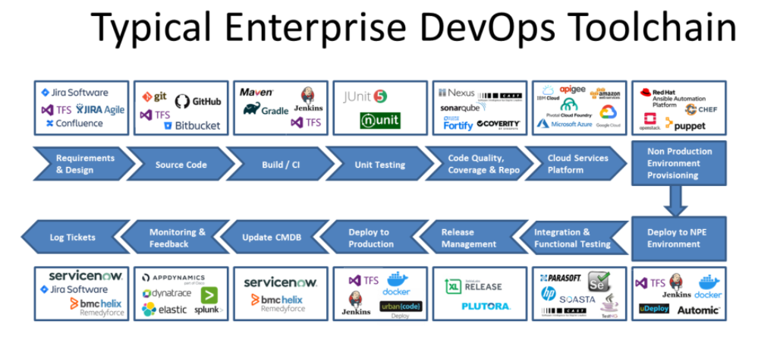

Slide 105
Git
Git is a distributed version control system used to track changes in source code during software development.
Install Git
First, you need to install Git on your computer. You can download it from git-scm.com.
Configure Git
After installing Git, you need to set up your user name and email address. Open your terminal or command prompt and type:
git config --global user.name "Your Name"
git config --global user.email "your.email@example.com"

Slide 106
Git
Basic Git Commands
Initialize a Repository
To start tracking a project with Git, navigate to your project directory and initialize a Git repository:
cd your-project-directory
git init
Check the Status
To see the status of your files (e.g., changes that need to be committed), use:
git status

Slide 107
Git
Add Files
To stage files for commit, use:
git add filename
To add all changes, use:
git add .
Commit Changes
To commit the staged files with a message, use:
git commit -m "Your commit message"

Slide 108
Git
Viewing the Commit History
To see the commit history, use:
git log
Create a Branch
To create a new branch and switch to it, use:
git branch new-branch-name
git checkout new-branch-name
git checkout -b new-branch-name

Slide 109
Git
Merge Branches
To merge a branch into your current branch, use:
git checkout main
git merge new-branch-name
Delete a Branch
To delete a branch that you no longer need, use:
git branch -d branch-name

Slide 110
Git
Pushing Changes
To push your changes to a remote repository, use:
git remote add origin https://github.com/your-username/your-repository.git
git push -u origin main
After the first time, you can simply use:
git push
Pulling Changes
To pull changes from a remote repository, use:
git pull

Slide 111
Git
Common Git Workflows
Cloning a Repository
To clone an existing repository from GitHub, use:
git clone https://github.com/username/repository.git
Working with Remotes
To list your remotes, use:
git remote -v
To add a new remote, use:
git remote add remote-name https://github.com/user/repo.git

Slide 112
Git
Stashing Changes
To stash your changes without committing them, use:
git stash
To apply stashed changes, use:
git stash apply

Slide 113
Git
git checkout feature-branch
git log --oneline
git checkout main
git cherry-pick <ABOVE COMMIT ID>
git push origin main

Slide 114
What is Jenkins?
Jenkins is a self-contained, open source automation server which can be used to automate all sorts of tasks related to building, testing, and delivering or deploying software.
Jenkins can be installed through native system packages, Docker, or even run standalone by any machine w bith a Java Runtime Environment (JRE) installed

Slide 115
Install Jenkins
Install Docker
https://github.com/arjunachari12/install-jenkins-container/blob/main/install-docker.md
Install Jenkins
https://github.com/arjunachari12/install-jenkins-container/blob/main/jenkins.md
Official link
https://www.jenkins.io/doc/book/installing/docker/

Slide 116
Pipeline
Jenkins Pipeline (or simply "Pipeline" with a capital "P") is a suite of plugins which supports implementing and integrating continuous delivery pipelines into Jenkins.
Pipeline provides an extensible set of tools for modeling simple-to-complex delivery pipelines "as code" via the Pipeline domain-specific language (DSL) syntax.
The definition of a Jenkins Pipeline is written into a text file (called a Jenkinsfile) which in turn can be committed to a project’s source control repository.
This is the foundation of "Pipeline-as-code"; treating the CD pipeline a part of the application to be versioned and reviewed like any other code.

Slide 117
Pipeline
Creating a Jenkinsfile and committing it to source control provides a number of immediate benefits:
Automatically creates a Pipeline build process for all branches and pull requests.
Code review/iteration on the Pipeline (along with the remaining source code).
Audit trail for the Pipeline.
Single source of truth for the Pipeline, which can be viewed and edited by multiple members of the project.
While the syntax for defining a Pipeline, either in the web UI or with a Jenkinsfile is the same, it is generally considered best practice to define the Pipeline in a Jenkinsfile and check that in to source control

Slide 118
Why Pipeline?
Jenkins is, fundamentally, an automation engine which supports a number of automation patterns.
Pipeline adds a powerful set of automation tools onto Jenkins, supporting use cases that span from simple continuous integration to comprehensive CD pipelines. By modeling a series of related tasks, users can take advantage of the many features of Pipeline:
Code: Pipelines are implemented in code and typically checked into source control, giving teams the ability to edit, review, and iterate upon their delivery pipeline.
Durable: Pipelines can survive both planned and unplanned restarts of the Jenkins controller.

Slide 119
Why Pipeline?
Pausable: Pipelines can optionally stop and wait for human input or approval before continuing the Pipeline run.
Versatile: Pipelines support complex real-world CD requirements, including the ability to fork/join, loop, and perform work in parallel.
Extensible: The Pipeline plugin supports custom extensions to its DSL footnote:dsl:[] and multiple options for integration with other plugins.
While Jenkins has always allowed rudimentary forms of chaining Freestyle Jobs together to perform sequential tasks, Pipeline makes this concept a first-class citizen in Jenkins.

Slide 120
Pipeline concepts
The following concepts are key aspects of Jenkins Pipeline, which tie in closely to Pipeline syntax
Pipeline:
A Pipeline is a user-defined model of a CD pipeline. A Pipeline’s code defines your entire build process, which typically includes stages for building an application, testing it and then delivering it.
Node:
A node is a machine which is part of the Jenkins environment and is capable of executing a Pipeline.

Slide 121
Pipeline concepts
Stage
A stage block defines a conceptually distinct subset of tasks performed through the entire Pipeline (e.g. "Build", "Test" and "Deploy" stages), which is used by many plugins to visualize or present Jenkins Pipeline status/progress.
Step
A single task. Fundamentally, a step tells Jenkins what to do at a particular point in time (or "step" in the process). For example, to execute the shell command make use the sh step: sh 'make'. When a plugin extends the Pipeline DSL, [1] that typically means the plugin has implemented a new step.

Slide 122
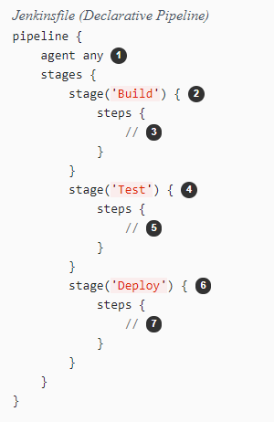
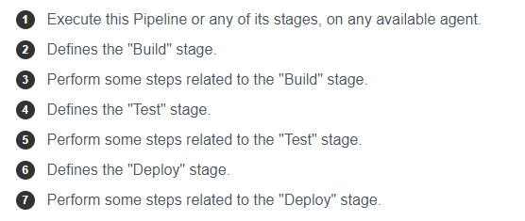
Declarative Pipeline

Slide 123
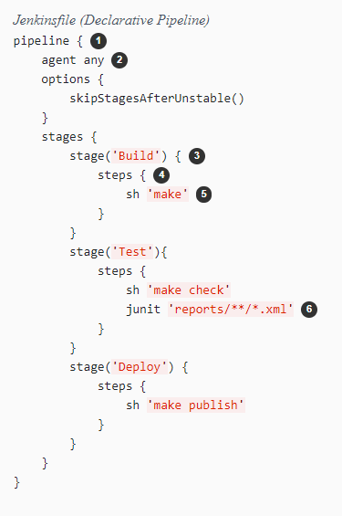
Pipeline example

Slide 124
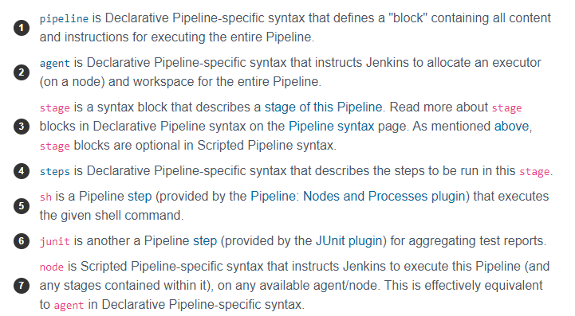
Pipeline example

Slide 125
Defining a Pipeline
Both Declarative and Scripted Pipeline are DSLs [1] to describe portions of your software delivery pipeline. Scripted Pipeline is written in a limited form of Groovy syntax.
A Pipeline can be created in one of the following ways:
Through Blue Ocean - after setting up a Pipeline project in Blue Ocean, the Blue Ocean UI helps you write your Pipeline’s Jenkinsfile and commit it to source control.
Through the classic UI - you can enter a basic Pipeline directly in Jenkins through the classic UI.
In SCM - you can write a Jenkinsfile manually, which you can commit to your project’s source control repository.

Slide 126
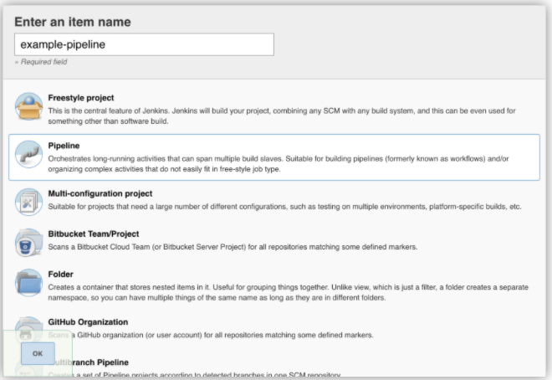
Through the classic UI

Slide 127
Exercise 1 - Create a pipeline as code to print hello world
Steps:
Create a new pipline, give a name as pipeline1
Under pipeline section Pipeline script option
Paste below code
pipeline {
agent any
stages {
stage('Stage 1') {
steps {
echo 'Welcome to jenkins!'
}
}
}
}

Slide 128
Exercise 2 - stages
stage('Test') {
steps {
echo 'Testing..'
}
}
pipeline {
agent any
stages {
stage('Build') {
steps {
echo 'Building..'
}
}
}
stage('Deploy') {
steps {
echo 'Deploying....'
}
}
}
}
pipeline {
agent any
stages {
stage('Build') {
steps {
echo 'Building..'
}
}
stage('Test') {
steps {
echo 'Testing..'
}
}
stage('Deploy') {
steps {
echo 'Deploying....'
}
}
}
}
https://www.jenkins.io/doc/book/pipeline/jenkinsfile/

Slide 129
Pipeline Syntax
https://www.jenkins.io/doc/book/pipeline/syntax/

Slide 130
Maven
Apache Maven is a build automation tool primarily used for Java projects. It addresses two main aspects of building software: managing dependencies and automating the build process.

Slide 131
Maven
Install JDK
Update package index:
sudo apt update
Install OpenJDK:
sudo apt install openjdk-11-jdk -y
Verify Java installation:
java -version
You should see output similar to:
openjdk version "11.0.11" 2021-04-20
OpenJDK Runtime Environment (build 11.0.11+9-Ubuntu-0ubuntu2.20.04)
OpenJDK 64-Bit Server VM (build 11.0.11+9-Ubuntu-0ubuntu2.20.04, mixed mode

Slide 132
Maven
Install Maven
Install Maven:
sudo apt install maven -y
Verify Maven installation:
mvn -version
You should see output similar to:
Apache Maven 3.6.3
Maven home: /usr/share/maven
Java version: 11.0.11, vendor: Ubuntu, runtime: /usr/lib/jvm/java-11-openjdk-amd64
Default locale: en_US, platform encoding: UTF-8
OS name: "linux", version: "5.4.0-42-generic", arch: "amd64", family: "unix

Slide 133
Maven
Compile and package the project:
mvn package
This will compile the code, run the tests, and package the project into a JAR file located in the target directory.
Run the packaged JAR file:
java -jar target/your-project-1.0-SNAPSHOT.jar
Replace your-project-1.0-SNAPSHOT.jar with the actual name of your JAR file.
https://maven.apache.org/

Slide 134
Exercise
Deploy java maven project
Create a new pipeline
Write pipeline in jenkins
https://github.com/arjunachari12/simple-java-maven-app
Deploy maven project with docker agent
Create a new pipeline
Fork the repo
Add Jenkinsfile
Add below content
https://github.com/arjunachari12/simple-java-maven-app

Slide 135
Nodejs

Slide 136
Assignment: Python
https://www.jenkins.io/doc/tutorials/build-a-python-app-with-pyinstaller/

Slide 137
Manage Jenkins
The "Manage Jenkins" section in the Jenkins UI provides various options to configure, manage, and maintain your Jenkins instance.
System Configuration
Configure System: Allows you to configure system-wide settings, such as global environment variables, paths to tools (e.g., JDK, Git), and other system settings.
Global Tool Configuration: Configure various tools used by Jenkins jobs, like JDK installations, Git, Maven, Ant, etc.

Slide 138
Manage Jenkins
Security
Configure Global Security: Set up security options, such as enabling/disabling security, configuring authentication (LDAP, OAuth, etc.), and authorization (Matrix-based security, Project-based security).
Manage Users: Manage user accounts, including creating, modifying, and deleting users.
Plugin Management
Manage Plugins: Install, update, and remove Jenkins plugins. The tab includes "Updates," "Available," "Installed," and "Advanced" sections to manage plugins effectively.

Slide 139
Manage Jenkins
Node Management
Manage Nodes and Clouds: Configure and manage build agents (nodes) and cloud configurations for scaling Jenkins across multiple machines or cloud instances.
Job Configuration
Configure Global Security: Set up security options, such as enabling/disabling security, configuring authentication (LDAP, OAuth, etc.), and authorization (Matrix-based security, Project-based security).

Slide 140
Manage Jenkins
System Information and Logs
System Information: View detailed information about the Jenkins instance, including environment variables, system properties, and more.
System Log: Access the Jenkins system log to monitor activities and troubleshoot issues.
Load Statistics: View statistics about the Jenkins server's load, including the number of executors and their usage.
Script Console
Script Console: Execute Groovy scripts directly on the Jenkins server. Useful for performing administrative tasks or troubleshooting.

Slide 141
Manage Jenkins
Maintenance
Reload Configuration from Disk: Reload the Jenkins configuration from disk. Useful if changes are made directly to the configuration files.
Safe Restart: Restart Jenkins safely, ensuring that running jobs complete before the restart.
Backup and Restore
ThinBackup: If you have the ThinBackup plugin installed, you can manage backup and restore operations for Jenkins configuration and jobs.

Slide 142
Manage Jenkins
Updates and Upgrades
Check for New Jenkins Version: Manually check for new Jenkins versions and update Jenkins to the latest version.
Miscellaneous
About Jenkins: Displays information about the current Jenkins version and links to documentation and support.
Jenkins CLI: Provides access to the Jenkins Command-Line Interface (CLI) for performing various administrative tasks from the command line.
Prepare for Shutdown: Puts Jenkins into a quiet mode, preventing new builds from starting while allowing existing builds to complete.

Slide 143
Using credentials
Using credentials in Jenkins involves securely storing sensitive information (like passwords, SSH keys, and API tokens) and using them in your Jenkins jobs.
There are numerous 3rd-party sites and applications that can interact with Jenkins, for example, artifact repositories, cloud-based storage systems and services, and so on.
A systems administrator of such an application can configure credentials in the application for dedicated use by Jenkins. This would typically be done to "lock down" areas of the application’s functionality available to Jenkins, usually by applying access controls to these credentials. Once a Jenkins manager (i.e. a Jenkins user who administers a Jenkins site) adds/configures these credentials in Jenkins, the credentials can be used by Pipeline projects to interact with these 3rd party applications.

Slide 144
Using credentials
Credentials stored in Jenkins can be used:
anywhere applicable throughout Jenkins (i.e. global credentials),
by a specific Pipeline project/item (read more about this in the Handling credentials section of Using a Jenkinsfile),
by a specific Jenkins user (as is the case for Pipeline projects created in Blue Ocean).

Slide 145
Using credentials
Jenkins can store the following types of credentials:
Secret text - a token such as an API token (e.g. a GitHub personal access token),
Username and password - which could be handled as separate components or as a colon separated string in the format username:password (read more about this in Handling credentials),
Secret file - which is essentially secret content in a file,
SSH Username with private key - an SSH public/private key pair,
Certificate - a PKCS#12 certificate file and optional password, or
Docker Host Certificate Authentication credentials.
https://www.jenkins.io/doc/book/using/using-credentials/

Slide 146
Using credentials: Adding Credentials
Adding Credentials
Navigate to Credentials:
Go to the Jenkins dashboard.
Click on "Manage Jenkins."
Click on "Manage Credentials."
Select the Credential Store:
Choose the appropriate domain (e.g., "Global" for global credentials).

Slide 147
Using credentials: Adding Credentials
Add Credentials:
Click on "(global)" (or the appropriate domain).
Click on "Add Credentials."
Select the type of credential you want to add from the dropdown menu (e.g., Username with password, SSH Username with private key, Secret text, Secret file, etc.).
Fill in Credential Details:
Enter the required information such as ID (optional), Description, Username, Password, etc.
Click "OK" to save the credential.

Slide 148
Using credentials in a Jenkins Job
Create or Configure a Job:
Go to the Jenkins dashboard.
Create a new job or configure an existing job.
Using Credentials in a Freestyle Project:
Source Code Management:
For Git, select "Git" under "Source Code Management."
In the "Credentials" dropdown, select the appropriate credentials.
Build Environment:
Check "Use secret text(s) or file(s)."
Add a "Bindings" step to bind the credential to an environment variable.

Slide 149
Using credentials in a Jenkins Job
Declarative Pipeline
pipeline {
agent any
environment {
MY_SECRET = credentials('my-credential-id')
}
stages {
stage('Example') {
steps {
echo "Using secret: ${MY_SECRET}"
}
}
}
}

Slide 150
Using Jenkins agents
The Jenkins architecture is designed for distributed build environments. It allows us to use different environments for each build project balancing the workload among multiple agents running jobs in parallel.
The Jenkins controller is the original node in the Jenkins installation. The Jenkins controller administers the Jenkins agents and orchestrates their work, including scheduling jobs on agents and monitoring agents. Agents may be connected to the Jenkins controller using either local or cloud computers.

Slide 151
SonarQube and SonarQube
https://sonarcloud.io/

Slide 152
Terraform with Jenkins - Workflow & Setup
Workflow Overview
Developer commits Terraform code → Stored in Git
Jenkins triggers pipeline → Runs on commit or scheduled time
Terraform execution via Jenkins:
terraform init → Initializes the working directory
terraform plan → Generates execution plan
terraform apply → Applies changes to infrastructure
Provisioned resources → Deployed on cloud (AWS/Azure/GCP)

Slide 153
Jenkins Setup for Terraform
Install Terraform plugin in Jenkins or use Terraform CLI in a Jenkins agent
Configure Jenkins pipeline to run Terraform commands
Use Jenkins credentials for cloud authentication (AWS IAM, Azure SPN, etc.)
Store Terraform state securely (e.g., AWS S3, Azure Blob, Terraform Cloud)

Slide 154
Exercise

Slide 155
Jenkins Security - Access & Authentication
🔹 Role-Based Access Control (RBAC) – Use the Role-Based Authorization Strategy plugin
🔹 Enable Security Realm – Use LDAP, Active Directory, or SSO
🔹 Disable Anonymous Access – Require authentication for all users
🔹 Enforce Strong Credentials – Use SSH keys & strong passwords
🔹 Use API Tokens – Avoid plaintext passwords for automation

Slide 156
Secure Communication, Agents & Pipelines
🔹 Enable HTTPS/TLS – Enforce encrypted communication via SSL
🔹 Secure Jenkins Agents – Use SSH-based connections, isolate agents with Docker/Kubernetes
🔹 Least Privilege Execution – Restrict pipeline permissions & file system access
🔹 Sanitize User Inputs – Prevent code injection attacks
🔹 Use the Credentials Plugin – Store secrets securely

Slide 157
Plugins, Infrastructure & Monitoring
🔹 Keep Plugins Updated – Remove unused & untrusted plugins
🔹 Run Jenkins as Non-Root – Reduce risk of privilege escalation
🔹 Enable Network Segmentation – Restrict Jenkins access via firewalls
🔹 Enable Audit Logging & Monitoring – Track security events with ELK/Splunk
🔹 Patch Regularly & Run Security Scans – Identify & fix vulnerabilities

Slide 158
Jenkins Backup Strategies
🔹 Why Backup Jenkins? – Protect job configurations, plugins, credentials, and logs
🔹 Backup Methods:
Full Backup – Copy the entire JENKINS_HOME directory
Incremental Backup – Use backup plugins to save only recent changes
Cloud & Offsite Backup – Store backups in S3, Azure Blob, or remote storage
Automated & Scheduled Backup – Use cron jobs or Jenkins job scheduling
🔹 Tools: ThinBackup Plugin, SCM Backup, Custom Scripts

Slide 159
Remote Testing in Jenkins
🔹 What is Remote Testing? – Executing tests on remote machines or cloud environments
🔹 Common Remote Testing Approaches:
Distributed Builds – Use Jenkins agents/nodes to run tests on remote servers
Cloud Testing – Leverage AWS Device Farm, Selenium Grid, or BrowserStack
Containerized Testing – Run tests in isolated Docker/Kubernetes environments
🔹 Key Plugins:
Selenium Plugin (for UI testing)
TestComplete Plugin (for functional testing)
Jenkins Remoting (for agent execution)

Slide 160
Best Practices for Backup & Remote Testing in Jenkins
✅ Automate Backups – Use plugins or scripts for scheduled backups
✅ Store Offsite Copies – Maintain backups on cloud or external storage
✅ Use Remote Agents – Distribute tests across multiple machines for scalability
✅ Monitor & Secure Remote Tests – Use logs, access controls, and encryption
✅ Integrate with CI/CD – Ensure remote tests run automatically after builds

Slide 161
Metrics and Performance Trends in Jenkins
🔹 Key Jenkins Performance Metrics:
Build Time – Measure execution time for jobs
Queue Length & Wait Time – Monitor job waiting time
CPU & Memory Usage – Track resource consumption of Jenkins master and agents
Executor Utilization – Ensure efficient agent usage
Failed vs. Successful Builds – Identify trends in job failures

Slide 162
Metrics and Performance Trends in Jenkins
🔹 Performance Monitoring Tools:
Jenkins Monitoring Plugin – Real-time performance insights
Prometheus & Grafana – Advanced dashboards for Jenkins metrics
New Relic, Datadog – Third-party monitoring solutions

Slide 163
Best Practices for Performance Optimization
✅ Use Distributed Builds with agents to balance load
✅ Limit concurrent jobs to prevent resource exhaustion
✅ Clean up old builds, artifacts, and logs regularly
✅ Tune JVM settings for optimal memory management
✅ Use Lightweight Pipelines instead of heavy Groovy scripts

Slide 164
Capstone Project
Objective:
Provision a scalable AWS infrastructure using Terraform and automate deployment with Jenkins Pipeline.
Tasks:
1. Provision AWS Resources using Terraform:
- EC2 Auto Scaling Group with an Application Load Balancer (ALB)
- S3 bucket for static content
- RDS (PostgreSQL/MySQL) with multi-AZ deployment
- VPC, Security Groups, Route 53, and IAM roles
- CloudWatch for monitoring
2. Automate Deployment with Jenkins Pipeline

Slide 165
Introduction to GitHub Actions
🚀 What is GitHub Actions?
A CI/CD platform for automating software development workflows.
Automates build, test, and deployment pipelines.
Triggers workflows based on events like pull requests, commits, or issues.
Supports Linux, Windows, and macOS runners, or self-hosted runners.
💡 Beyond CI/CD
Can automate GitHub repository tasks (e.g., labeling issues).

Slide 166
Core Components of GitHub Actions
Workflows – Automation logic for running tasks.
Events – Triggers that start workflows.
Jobs – A set of steps executed in sequence or parallel.
Steps – Individual commands or actions within a job.
Actions – Reusable components for common tasks.
Runners – Servers that execute workflows.

Slide 167
Understanding Workflows
Defined using YAML files in .github/workflows/.
Trigger types:
Event-driven (e.g., push, pull_request)
Scheduled (cron jobs)
Manual (workflow_dispatch)
Examples of Workflows:
Build & test code
Deploy applications
Automate issue management

Slide 168
Events and Triggers
An event starts a workflow (e.g., code push, issue creation).
Examples:
push → Run CI pipeline.
pull_request → Run tests before merging.
schedule → Automate tasks using CRON syntax.
workflow_dispatch → Manually triggered workflows.

Slide 169
Jobs and Actions
Jobs:
Run inside separate runners.
Can execute in parallel or be dependent on other jobs (needs:).
Actions:
Pre-built or custom components that automate tasks.
Found in GitHub Marketplace.
Example: actions/checkout@v4 (clones the repo).

Slide 170
Exercise
Write simple workflow
https://github.com/arjunachari12/GitHub-action1

Slide 171
Exercise 2
Workflow for Java app

Slide 172
Github action templates
https://docs.github.com/en/actions/writing-workflows/using-workflow-templates

Slide 173
Workflow syntax
https://docs.github.com/en/actions/writing-workflows/workflow-syntax-for-github-actions

Slide 174
Workflow with Terraform
Ec2: https://github.com/arjunachari12/Jenkins-terraform-ec2
S3
Capstone

Slide 175
Additional topic
Jenkins node setup
Slef hosted server github
Custom actions
Jenkins reusability

Slide 176
Q&A

Slide 177
Local Setup
Jenkins
Terraform
VS Code

